Slide 1
Movie Recommendation System
Course Name: CUS 695 Software Implementation Project
Professor: Dr. Giancarlo Crocetti
Prepared by: Nikunj Arun Lotia, Firasat Khan, Preeti Gupta & Majid Zia

Slide 2
MovieLens Dataset
Data Sheets provided and their attributes:
Link.csv : Movieid, imdb, tmbdlb
Movies.csv: movieId ,title ,genres
Ratings.csv: userId ,movieId, rating, timestamp
Tags.csv: userId, movieId, tag ,timestamp
For this project we have used ratings.csv as the primary datafile and movies.csv for mapping movie names during the validation process.
Attributes used during our project: userid, movieid, rating from ratings datafile and title from movies datafile.

Slide 3
What is movie recommender system?
The system that helps the user to recommend movies he would like to watch based on the movies lists which he has.
Additionally in this project we have the system configured that gives an estimate ratings of the unwatched predicted movies from the user list as per the recommendation.

Slide 4
Code flow
1.Load the data in csv.
(find the unique user and movie id )
2.Divide the data into Training and testing dataset using Knn (75% and 25% respectively)
3.Form Matrix of userid , movieid, ratings using pivot function
4.Use the pivot matrix to form the Cosine Matrix to study user similarity
5.Using Cosine matrix to find the three closest user against the chosen user
6. Find the movie information against the three closest user
6.Predict the movie for the selected user by calculating average ratings of those predicted movies from step 6

Slide 5
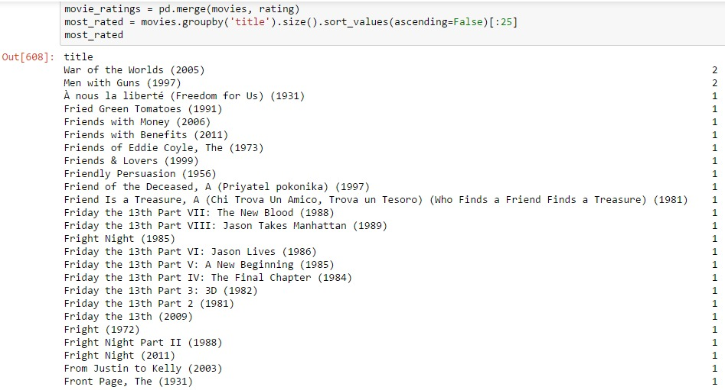
The Top 25 rated movies

Slide 6
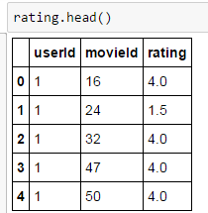
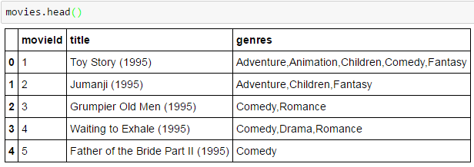
Loaded Data information & splitting data
Rating csv data
Movies csv data
Total Number of unique users = 668 and total Number of unique movies = 10325
Data is divided into training and testing using random 75:25 ratio
75 -> Training set
25 -> Testing set

Slide 7
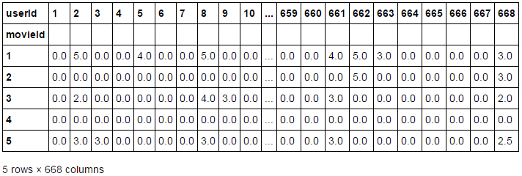
Matrix of userid , movieid & ratings

Slide 8

Cosine Matrix user-user similarity
Example of user to user similarity matrix for user 1 against itself and only 9 other users.

Slide 9

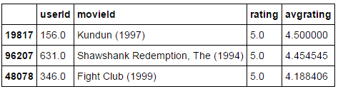
Finding closest users & predicting movies from these users
Asking user to input a particular user id from the dataset and find the 1st, 2nd & 3rd closest users to that user id
Finding top rated movies and their ratings(actual and average)

Slide 10
Movies & Rating Prediction
Movie prediction for user id: 1
Ratings prediction

Slide 11
Output for rating prediction for selected user(1)
The predicted rating for Shawshank Redemption, The (1994) should be between 4.5 and 5.0
The predicted rating for Usual Suspects, The (1995) should be between 4.3 and 4.0
The predicted rating for Casablanca (1942) should be between 4.2 and 4.0

Slide 12
Conclusion
Successfully predicted the movies.
Additionally predicted the ratings for the predicted movies.

Slide 13
References
https://movielens.org
https://www.analyticsvidhya.com
www.online.cambridgecoding.com
www.stackoverflow.com

Slide 14
Thank You

